Slide 1
Use complex techniques to develop a digital media outcome Walter Savage

Slide 2
Step 1 : Empathize

Slide 3
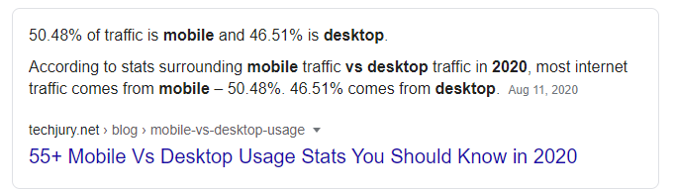
Task 1 : Identify your client and the purpose of your website, who is your target audience?
My Client is Myself. The purpose of my outcome is to give OBHS basketball a platform other than Facebook to update and inform fans and people of basketball in Dunedin and Nationally. My target audience is anywhere from primary school students to Grandparents so my website will have to cater for all needs. The most common screen width is mobile so my design will be optimized for mobile.

Slide 4
Accessibility
Accessibility is about how accessible the website is for every user.
To ensure that the accessibility is up to scratch I will ensure that the outcome can be viewed in many browsers and is able to be accessed across a range of devices.
I will also add alt tags to images to ensure people can grasp what the image is showing.
Notes:
Identify and explain 3 relevant implications that you will focus on during the creation of your project

Slide 5
Copyright
Copyright is to abide copyright laws and ensure we have permission to use the images and content on our website.
In my case I need to contact Brent Matahaere head of Basketball at OBHS to see if I can use the content from the Facebook page and use the OBHS Basketball Logo
Ill also need to contact Angela Ruske who takes photos of the OBHS basketball teams. I will use her photography in my website if granted permission.
Notes:
Identify and explain 3 relevant implications that you will focus on during the creation of your project

Slide 6
Aesthetics
Aesthetics is all about looks and how the website makes you feel. To ensure my website feels welcoming I will use the colours I’m given to make the page feel warm and welcoming using bright highlights and title colours. Also to make the website pleasing to look at I can limit the amount of white space and structure, so it is minimalistic and nice on the eyes.
Notes:
Identify and explain 3 relevant implications that you will focus on during the creation of your project

Slide 7
What are your client’s specifications?
The website must include four linked pages, the Home page, Team page, news page and a gallery page.
Colour scheme must follow those worn on the OBHS basketball uniform.
Includes link to the OBHS Basketball Facebook page in the header and footer.

Slide 8
Step 2 : Define

Slide 9
Website Structure
Website Site Map
index.html
team.html
news.html
gallery.html

Slide 10
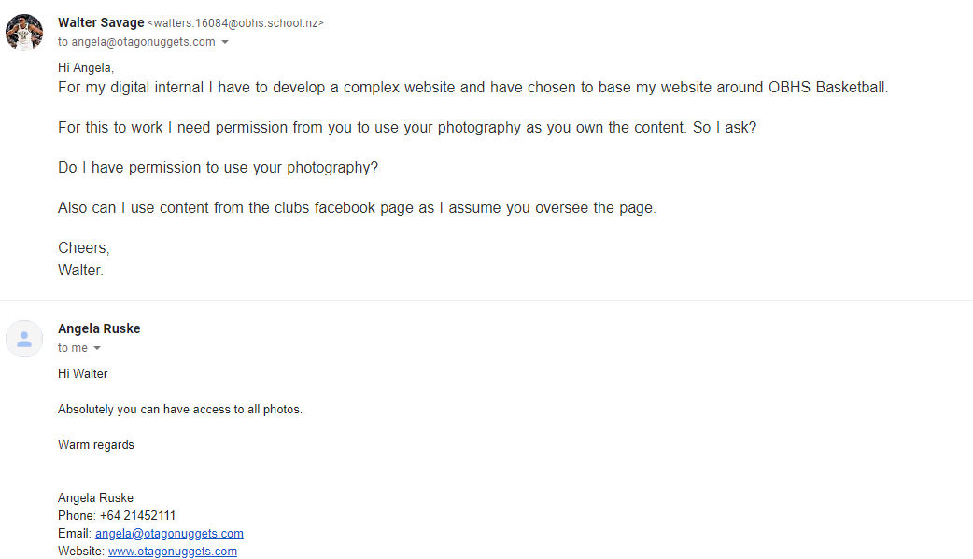
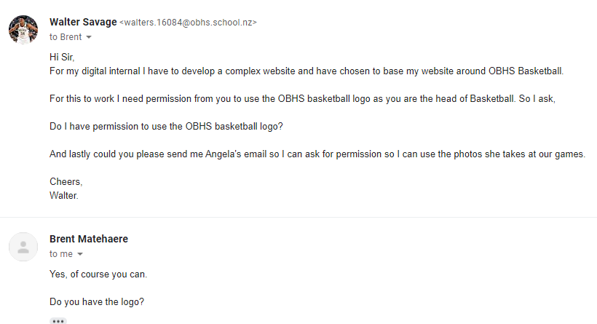
Evidence of written permission

Slide 11
Data Integrity Gather content – proofread and edit
Notes:
Data integrity is ensuring the information displayed is up to date , spelled correctly . Do F7 on your word content.
Testing

Slide 12
Gather Content
Notes:
Save images to an appropriate name folder
Compress / edit images where need be
Name the files accurately e.g home_mainimage.jpeg suzanne_collins_closeup.jpeg rather than 249784sflkjfnjksfxn3r8.jpeg
Record this process

Slide 13
Step 3 : Ideate

Slide 14
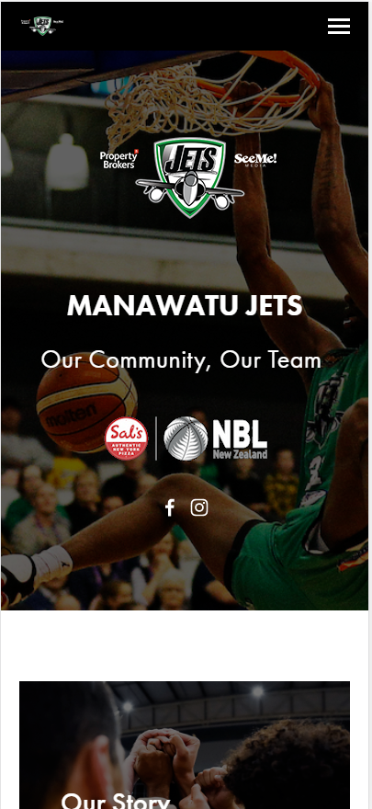
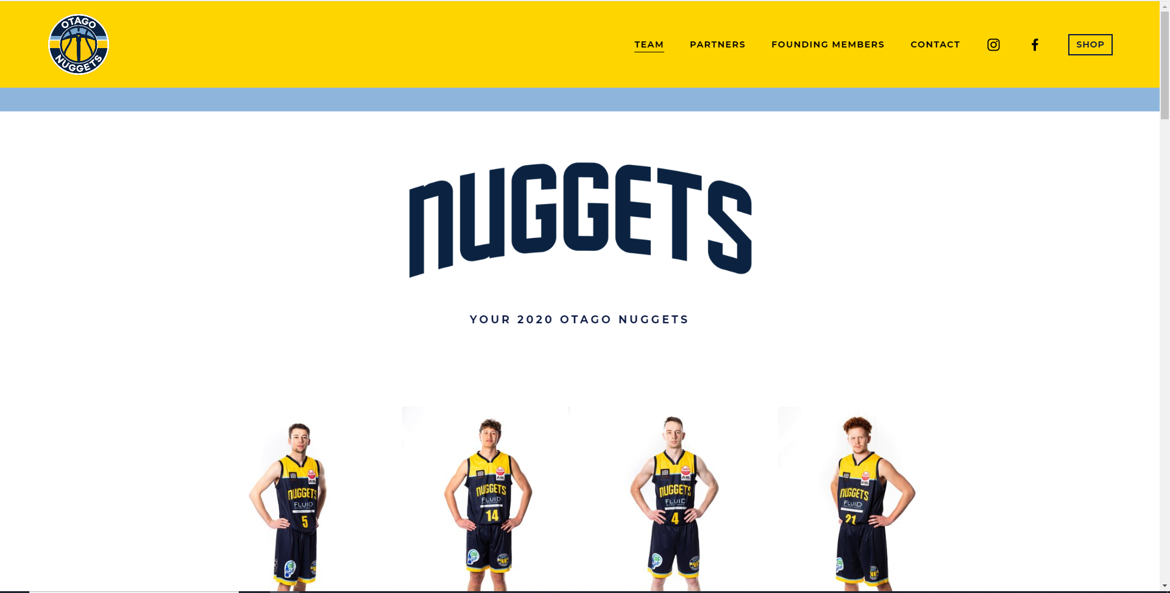
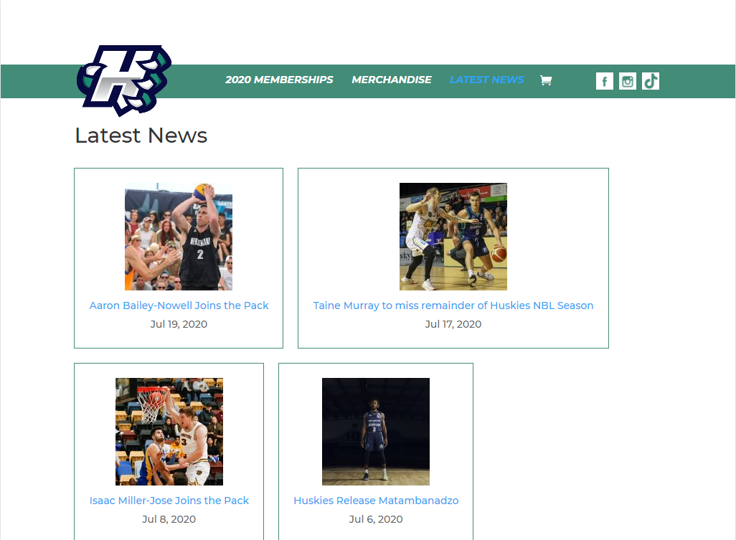
Trends

Slide 15
Trends
Looking at other NZ basketball club websites there are a lot of trends I would like to carry over.
One is when entering the home page they have a simple header with a large image with the team logo over laid, this looks very professional which I intend to carry over.
They also tend to incorporate secondary logos which I intend to created and incorporate into the design.

Slide 16
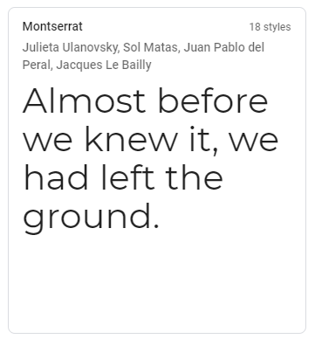
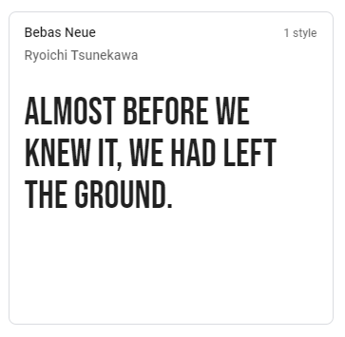
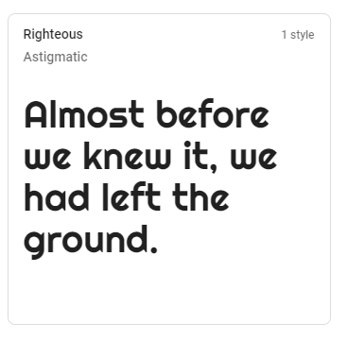
Font Combinations: Header
Vote: 1111
Vote: 1
Vote: 11

Slide 17
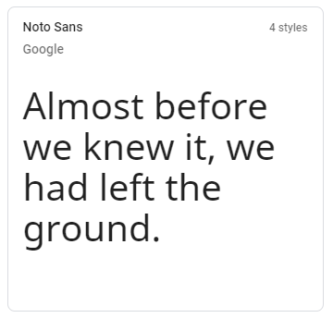
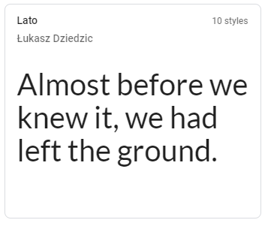
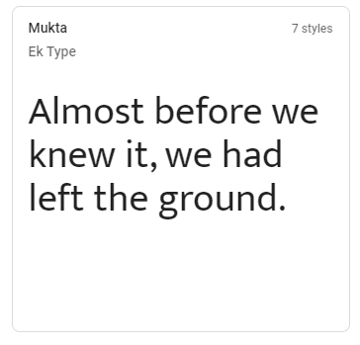
Font Combinations: Body
Vote: 11
Vote: 11
Vote: 1111

Slide 18
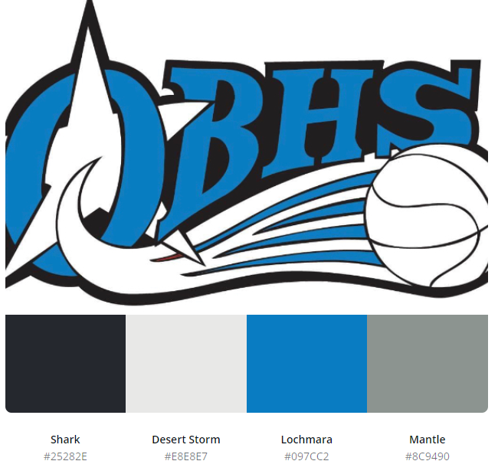

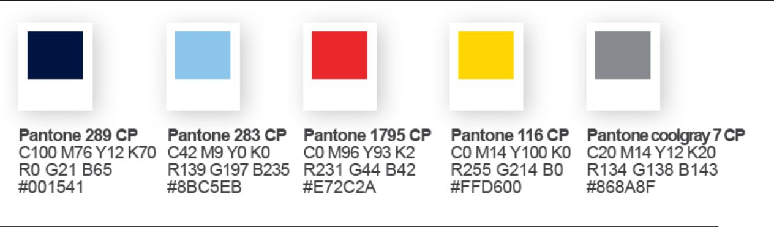
Vote: 11
Vote: 111111
Vote: 1

Slide 19
Low fidelity wireframes
Notes:
Use either

Slide 20
A vs B testing - colours
Notes:
Give two layout options for the index page – eg placement of cotent . Get feedback from client

Slide 21
A vs B testing - fonts
Notes:
Give two layout options for the index page – eg placement of cotent . Get feedback from client

Slide 22
Feedback from client / stakeholders
Notes:
Get written feedback, then add your own reflections:
What changes do you need to make and why? Do you need to carry out further research or give more colour/font options etc/

Slide 23
Step 4 : Protype/ Testing

Slide 24
Site setup

Slide 25
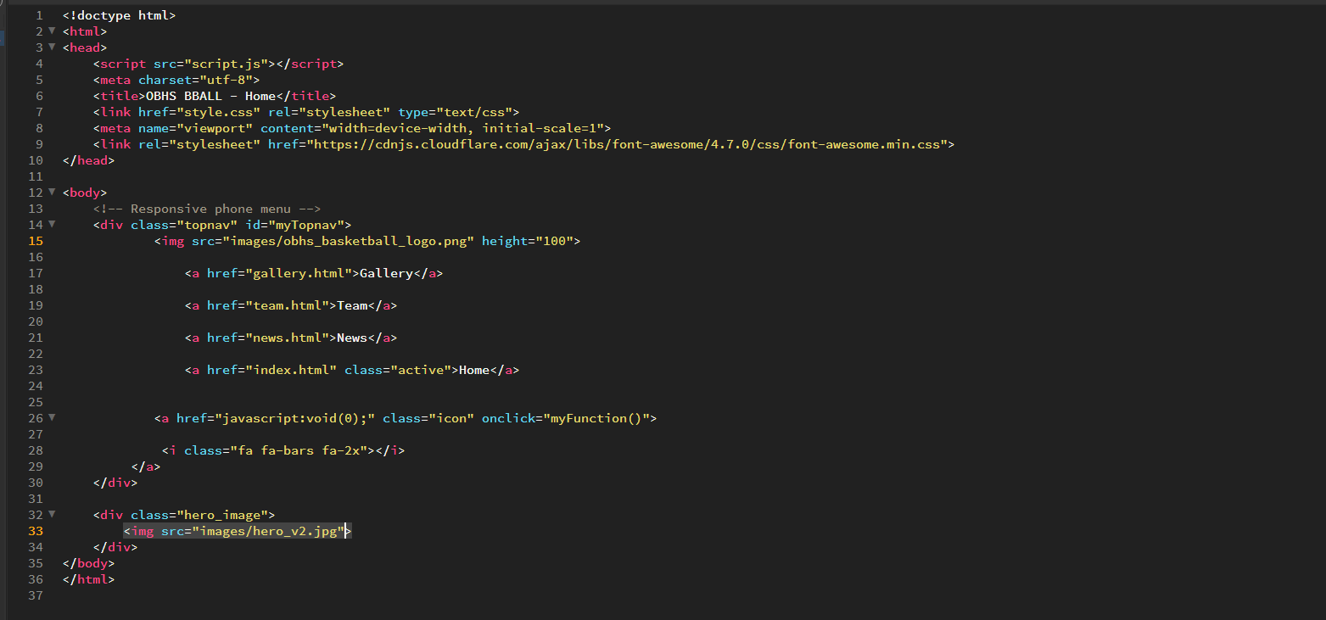
Index.html prototyping day 1

Slide 26
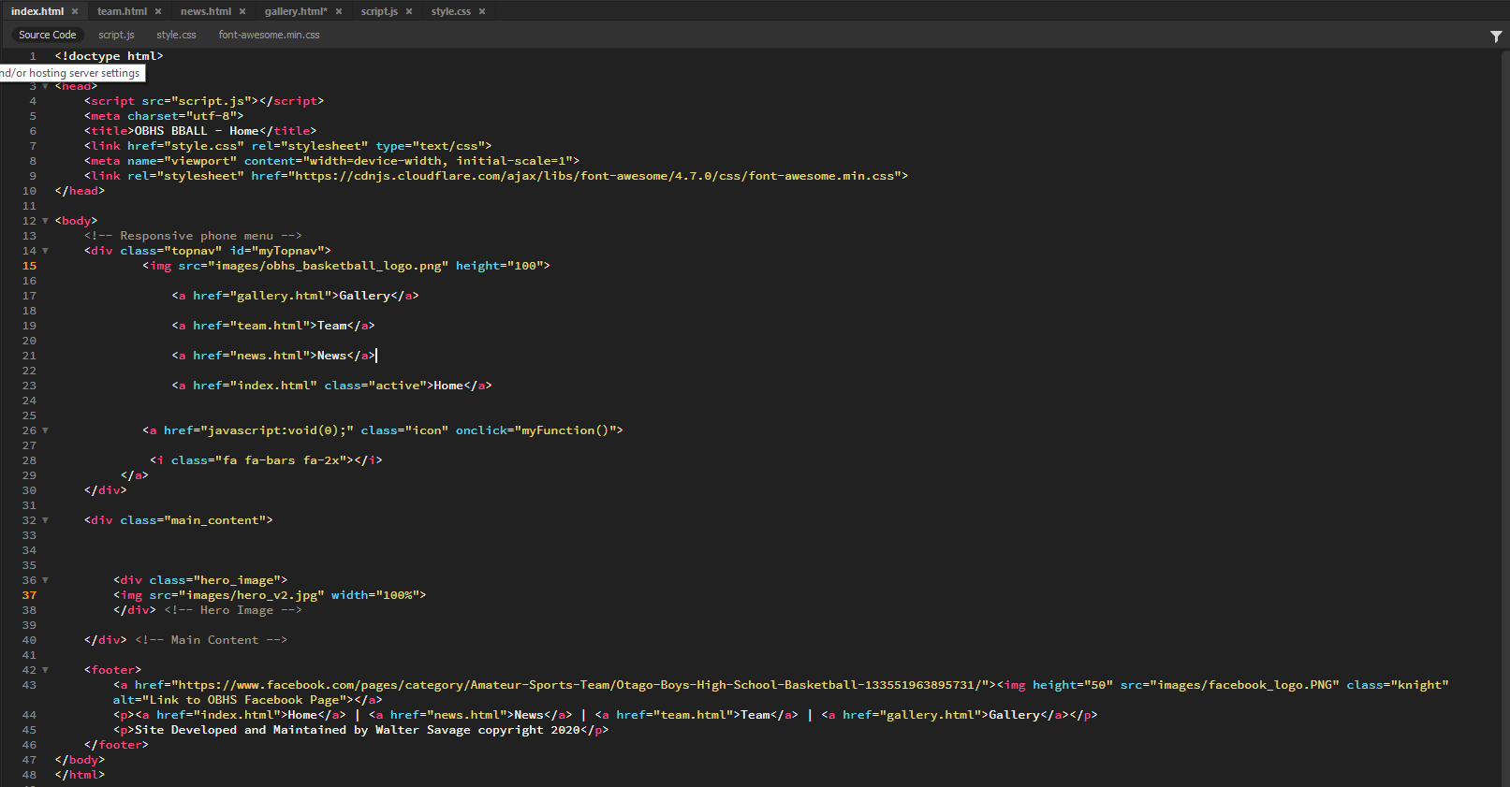
Index.html prototyping day 2

Slide 27
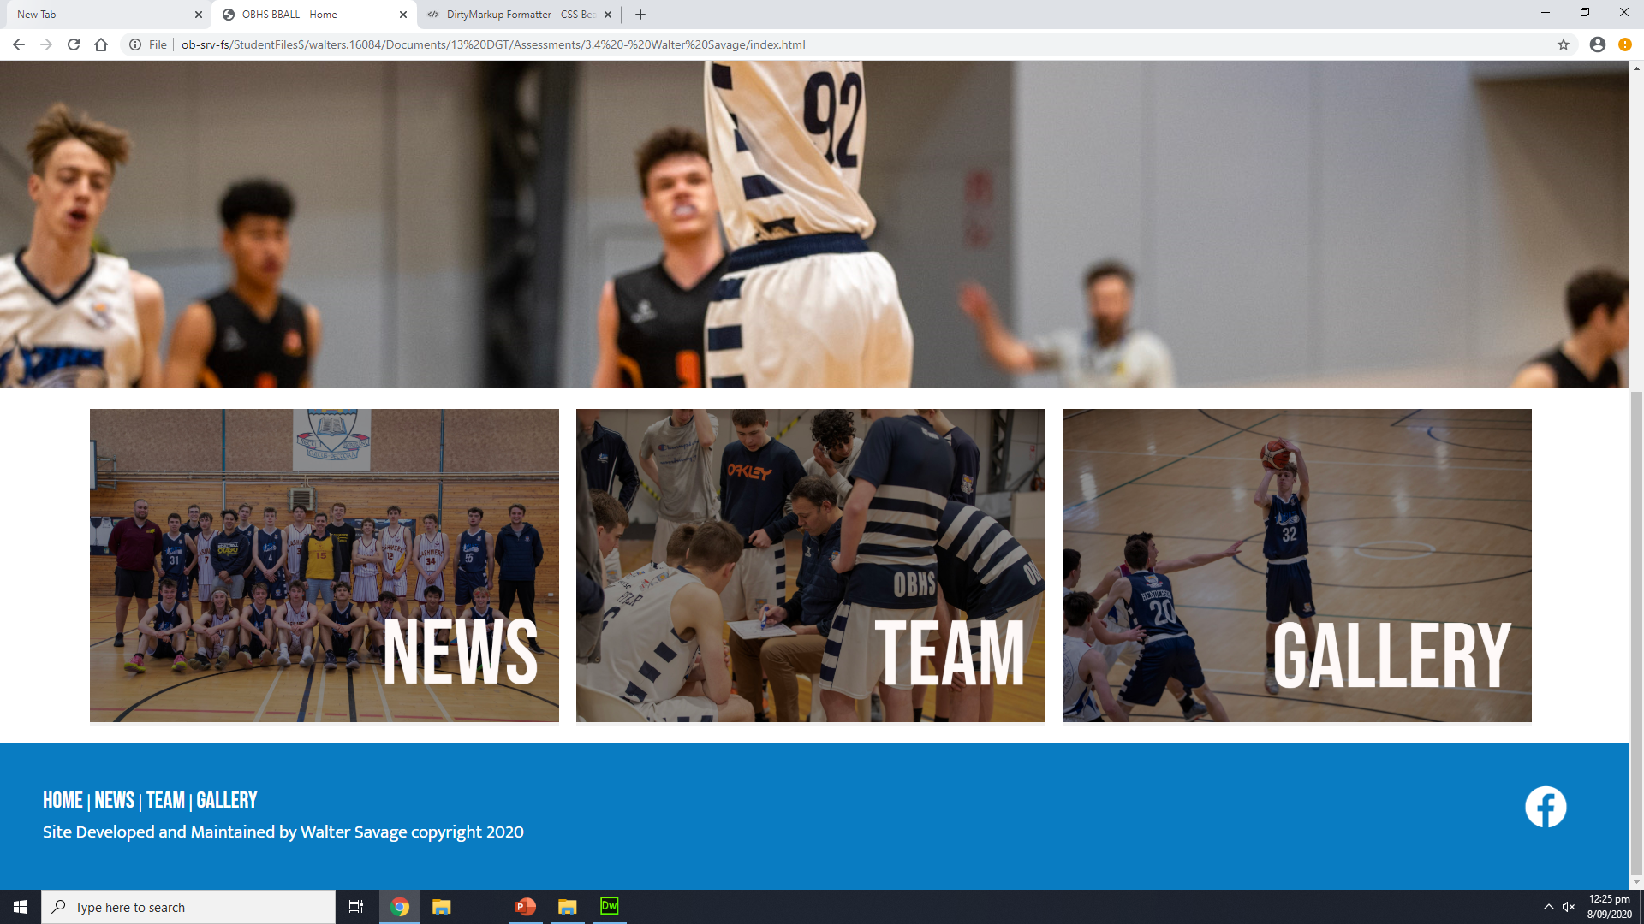
Day 4… Finished Index Page

Slide 28
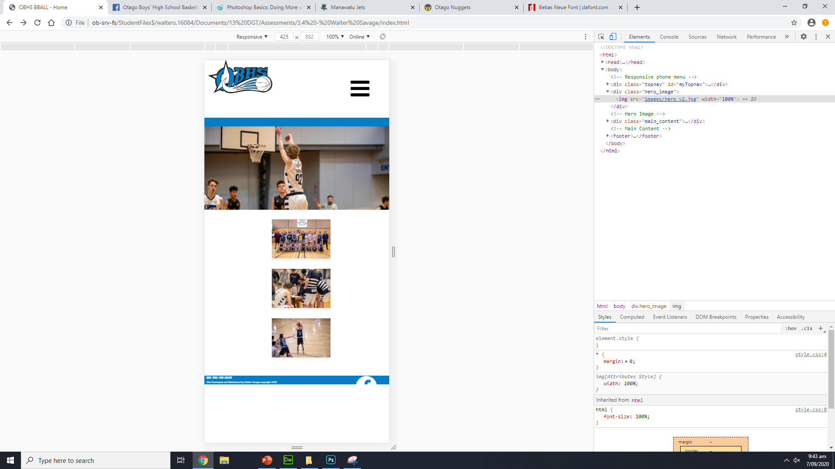
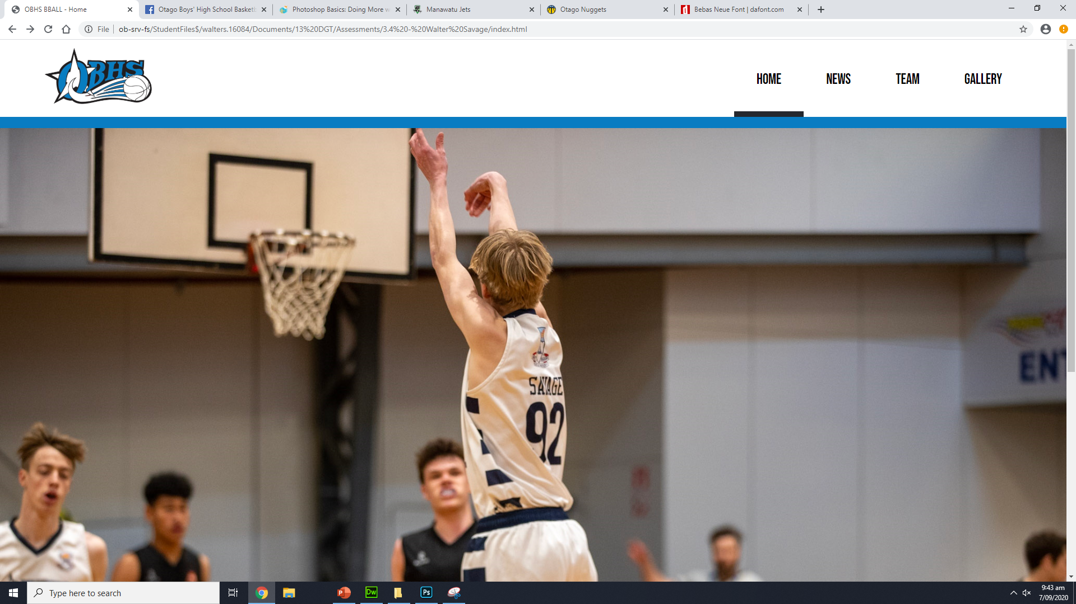
Feedback

Slide 29
Feedback
Nice use of colours the page scales down well also
The logo stays as a different size on phone view than the hamburger icon. It should be a little bit larger.

Slide 30
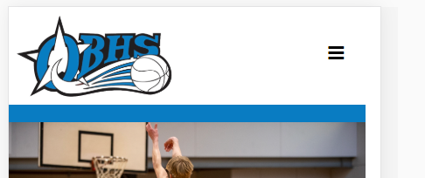
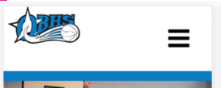
Response to feedback
The website now scales down at every device width. The logo problem was fixed.

Slide 31
Evidence of iterative improvement

Slide 32
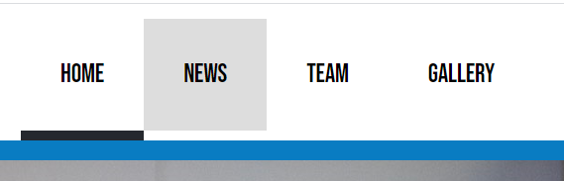

I added a border bottom on the hover to get rid of the white gap, this looks cleaner on the eye.
before
after

Slide 33
Testing Scaling: Phone vs Tablet vs Desktop
Notes:
Test your site on mobile, tablet and pc view

Slide 34
Testing Procedures: Validating the HTML/CSS
Notes:
Validate your HTML/CSS3 website – screenshot the no errors.

Slide 35
Applying the UX (BASIC priniciples)to improve your design
Notes:
Identify which usability principles you have applied to improve the quality of your design – screenshot your design, place in your portfolio and annotate and explain how it improved the usability, aesthetics or functionality etc.

Slide 36
Explain how your final design addressed the relevant implications

Slide 37
Addressing relevant implication :

Slide 38
Addressing relevant implication :

Slide 39
Final website
Notes:
Create a video of your site in desktop view, slowly going through the content, scale it down to phone view too,. Insert the video above

Slide 40
Final feedback from client

